Slide 1





The Green Mile: Justice And Redemption
Presented By:
Calistus Chris Gomes:22101189
Samuel Emon Halder:22101183
MD Sarjil Hasan:22101168
Priya Rani Das:22101192
Presented To:
Sumaia Jahan Shoshi
Pinky Akter:22101156
Lecturer
University Of Asia Pacific

Slide 2
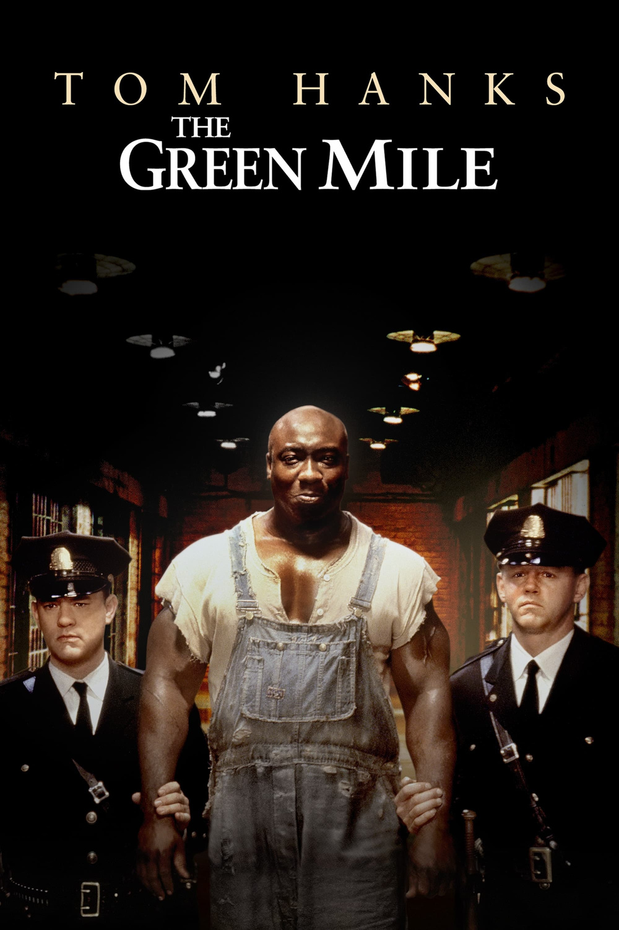

The Green Mile: Time takes it all, whether you want it to or not.
Welcome to our presentation on The Green Mile, a captivating film that delves into themes of morality, redemption, and the human spirit.
Notes:
1

Slide 3
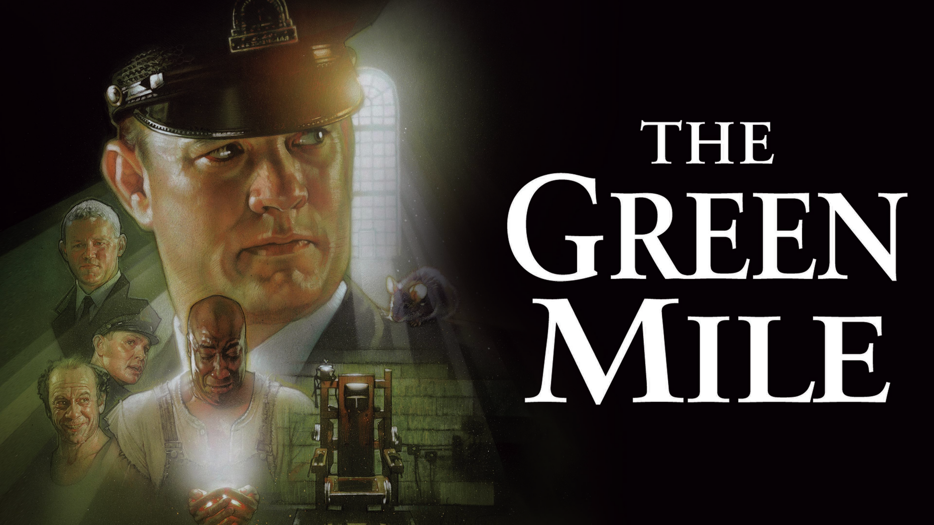

Background: The Movie, Director, and Themes
Release and Adaptation
1
The Green Mile, released in 1999, is a film adaptation of Stephen King's novel of the same name.
2
Frank Darabont's Vision
Themes Explored
3
The Green Mile explores themes of redemption, morality, and the complex nature of justice, all set against the backdrop of a prison.
Directed by Frank Darabont, known for his work on The Shawshank Redemption, the film captures the essence of King's storytelling.
Notes:
2

Slide 4
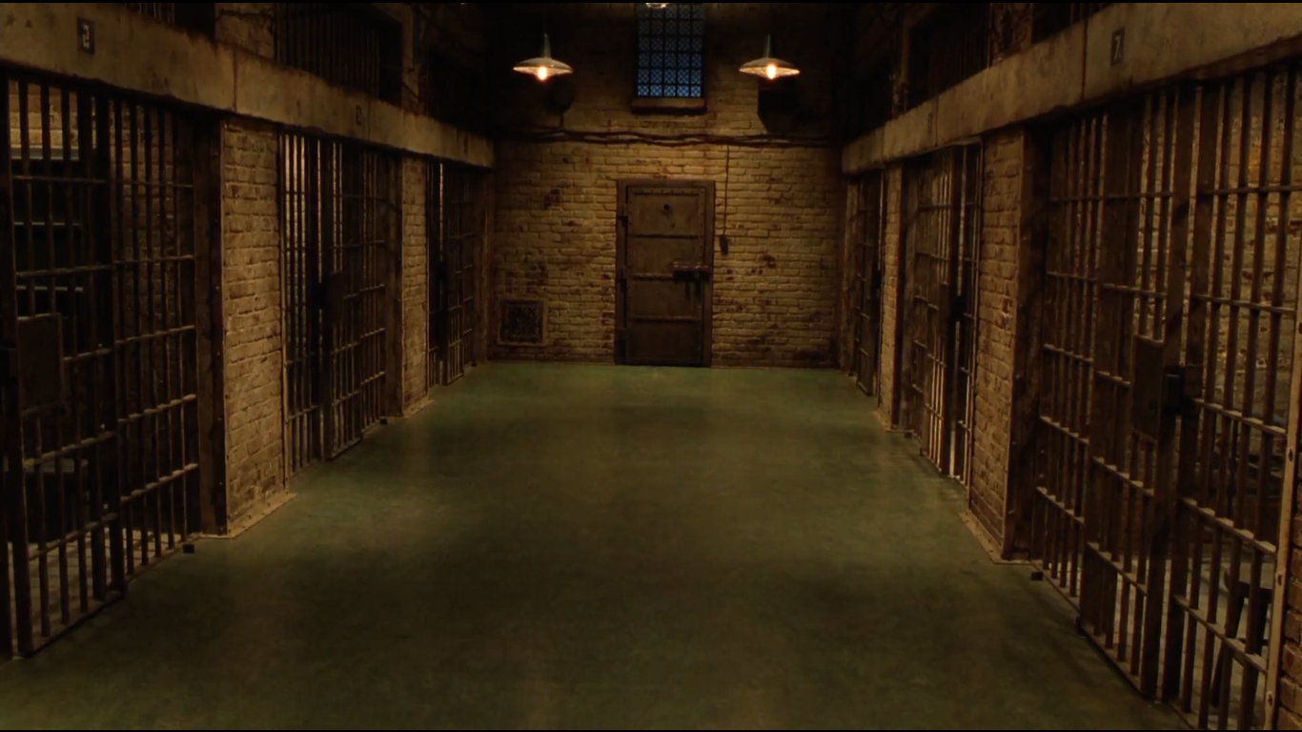

The Green Mile: Path to the “Finality”
The death row is usually called “The Last Mile”, but here it was rebranded with a stark and unforgettable visual connection.
At Cold Mountain, this path earned its name because its floor color was faded green.
The Green Mile was the final walk for prisoners, a path leading them from their cells to the electric chair.
The journey along the Green Mile was both literal and symbolic, marking the end of a prisoner’s story.

Slide 5

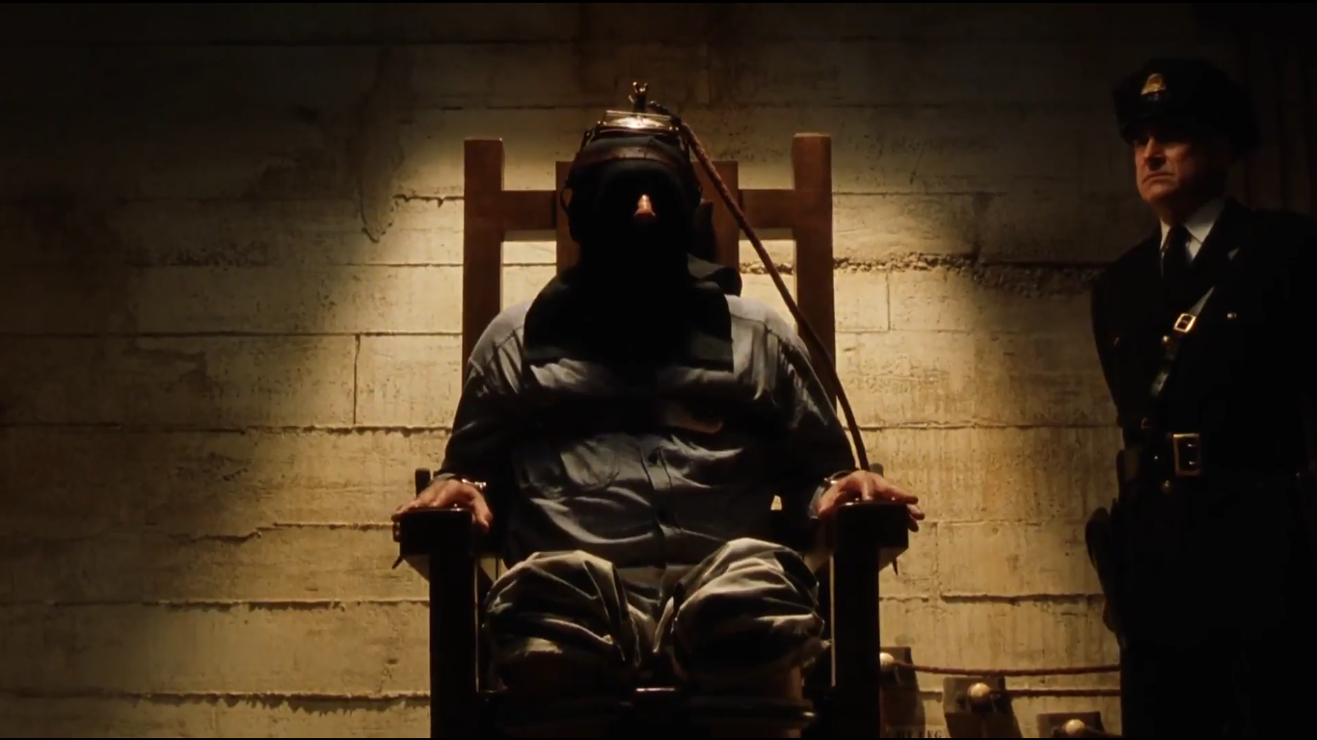
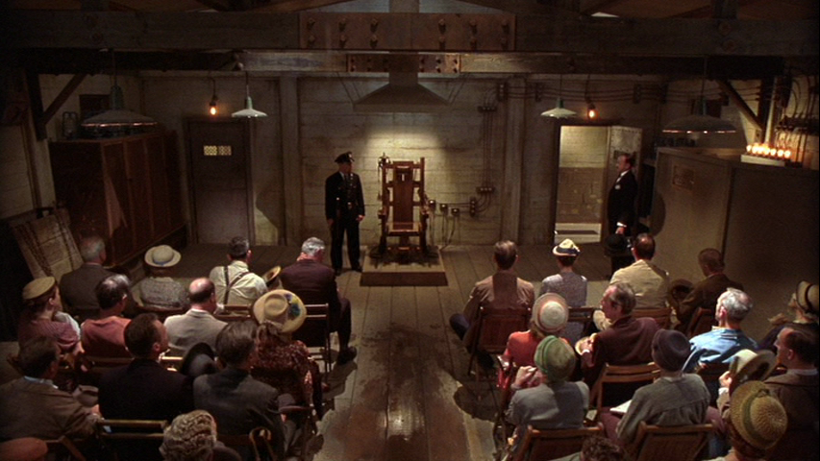
THE EXECUTION
"Old Sparky"
The execution chamber stood as a place of finality, where justice and morality intersected.
Witnesses to the execution bore silent testimony to the gravity of the law’s ultimate punishment.
The chamber, dimly lit and heavy with the weight of finality , became the setting for the irreversible conclusion of a prisoner’s story.

Slide 6

CHARACTERS

Slide 7



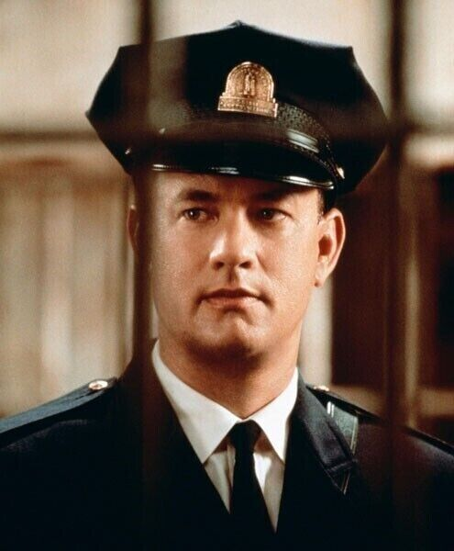


Paul Edgecomb
Paul Edgecomb is the head guard on death row at Cold Mountain Penitentiary.
A compassionate and fair leader, he ensures the humane treatment of inmates
.
His interactions with John Coffey challenge his beliefs about justice and morality.
Represents empathy and the emotional toll of enforcing capital punishment.
Embarks on a transformative journey, questioning the true meaning of justice.
Paul Edgecomb in the Miles

Slide 8


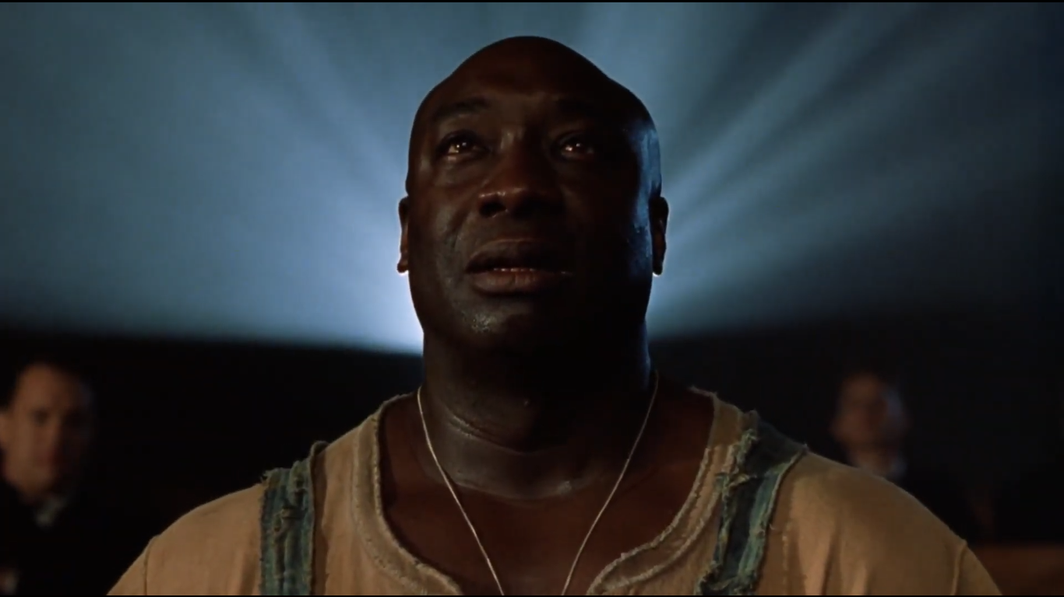


John Coffey
John Coffey is a gentle, soft-spoken death row inmate.
Wrongly convicted for crime he didn’t commit
Possesses miraculous healing powers, symbolizing purity and divine intervention.
Represents themes of sacrifice, empathy, and the injustice of the legal system.
His tragic execution highlights societal flaws and the cost of misunderstanding others.

Slide 9
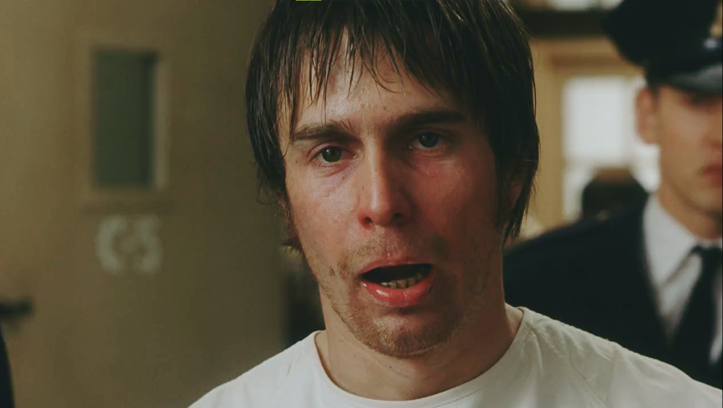
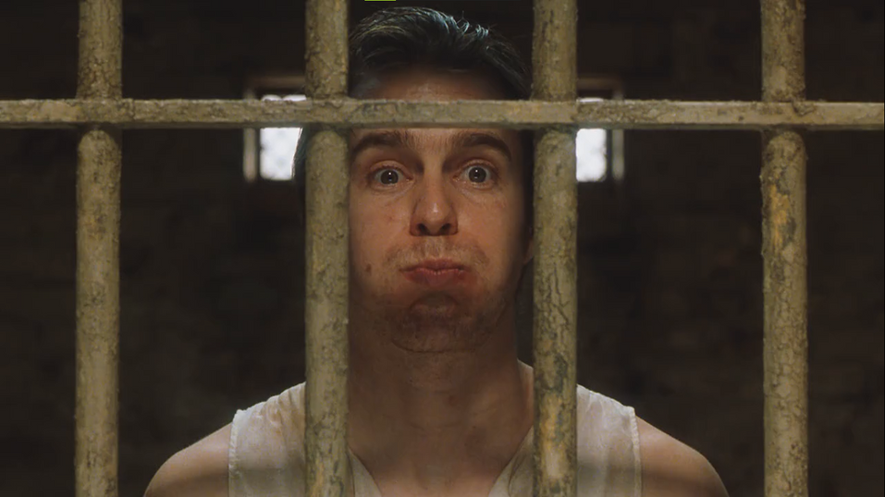
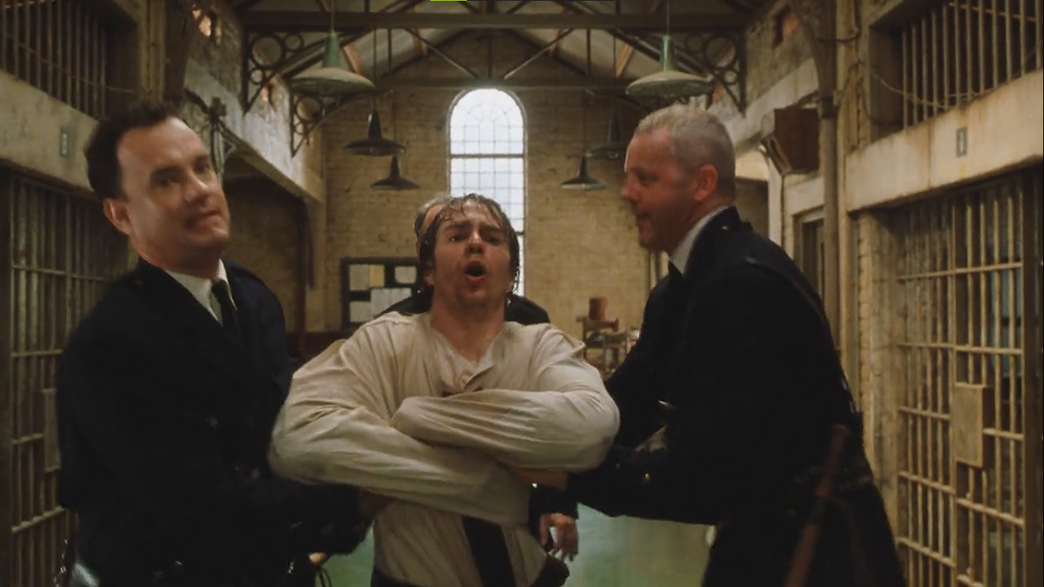
William ‘Wild Bill’ Wharton
"Wild Bill" Wharton is a violent and unpredictable death row inmate.
Known for his sadistic behavior and lack of remorse for his crimes.
Creates chaos among the guards and inmates with his erratic actions.
Secretly responsible for the crime John Coffey was falsely convicted of.
Symbolizes pure evil and the darker side of humanity within the film.

Slide 10
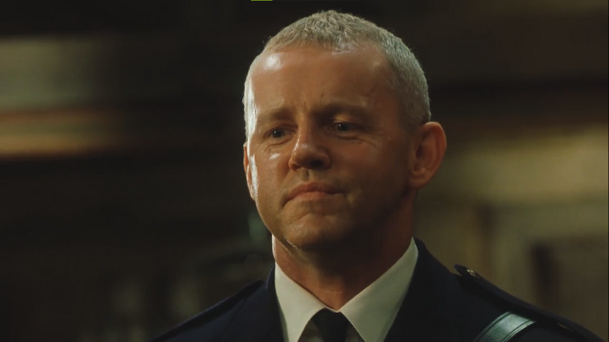
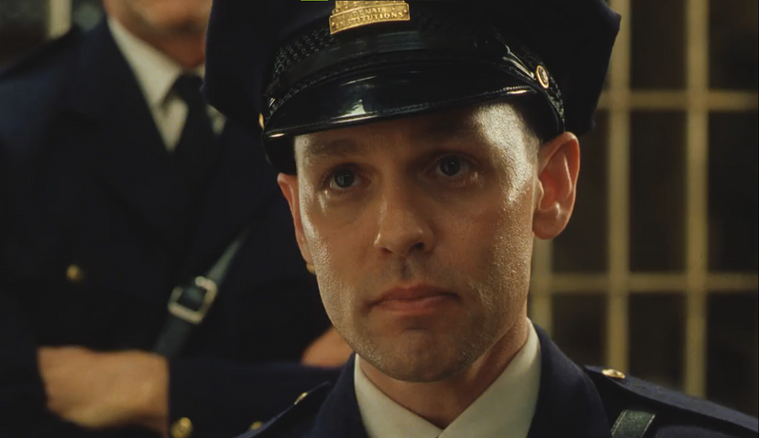

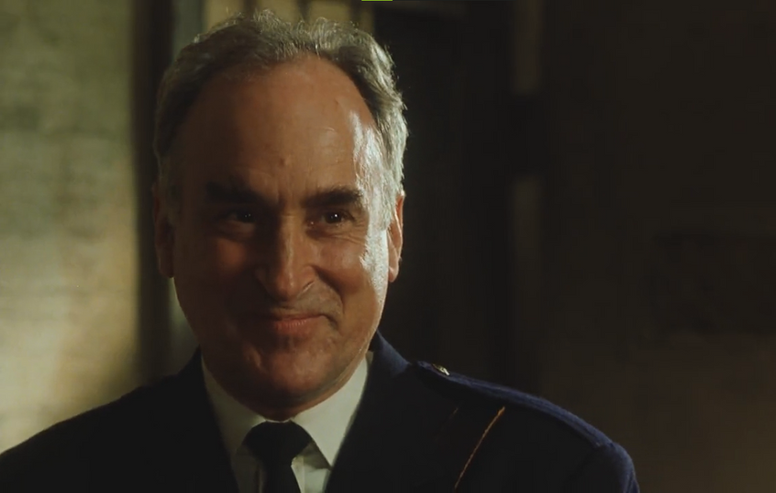
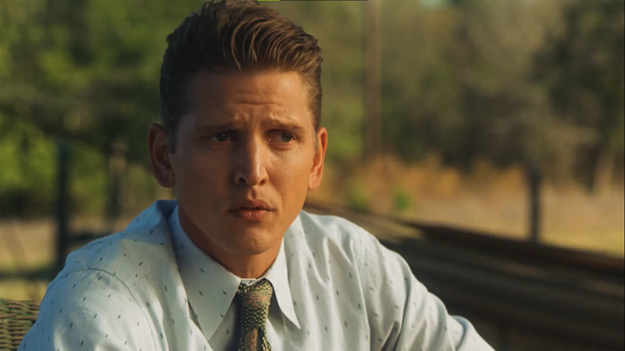

Character Introduction
Brutus Howell
Percy Wetmore
Egoistic and uses his power for selfish reasons
Paul’s good friend, always helpful to him.
Harry Terwilliger
Dean Stanton
Another of Paul’s friend who was helpful throughout the story
Eldest among the prison guards.

Slide 11
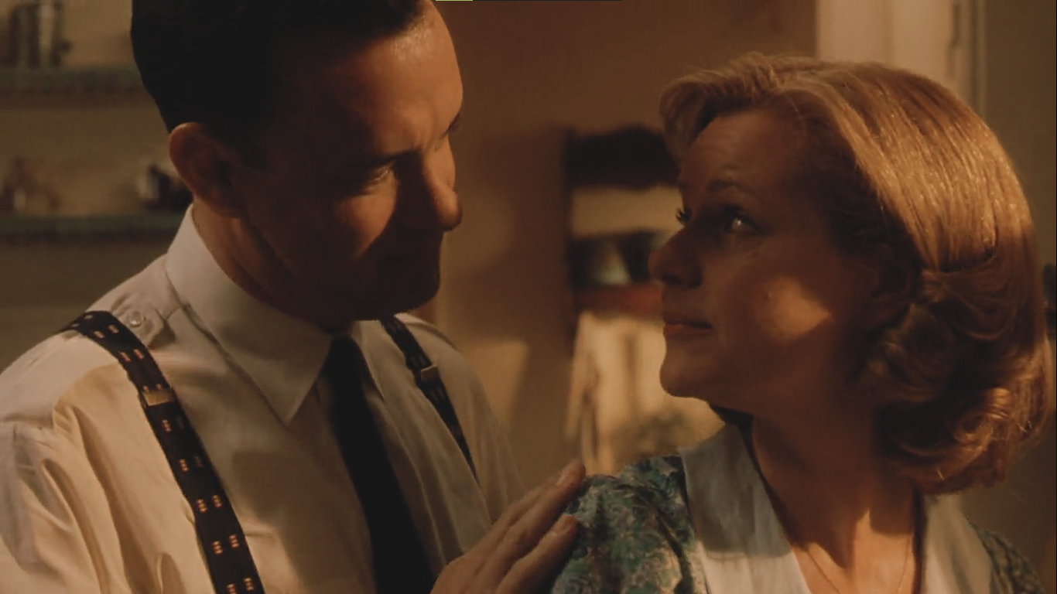
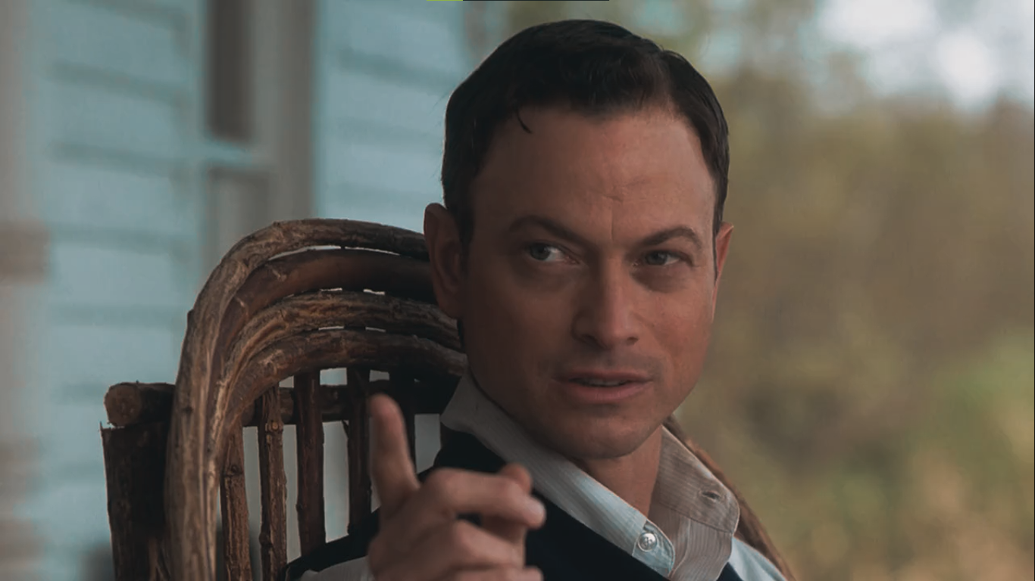
Burt Hammersmith
Burt Hammersmith is the man who was handling John Coffey’s case before he was sent to the death row.
Jan Edgecomb
Paul’s wife who is very supportive and trusts in everything he says without question.

Slide 12


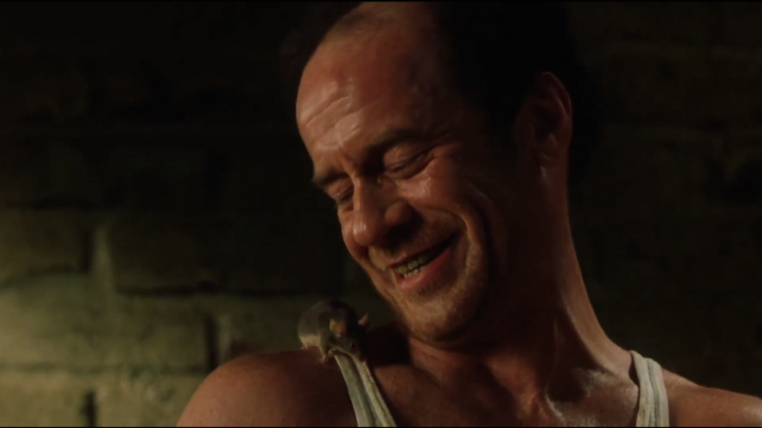
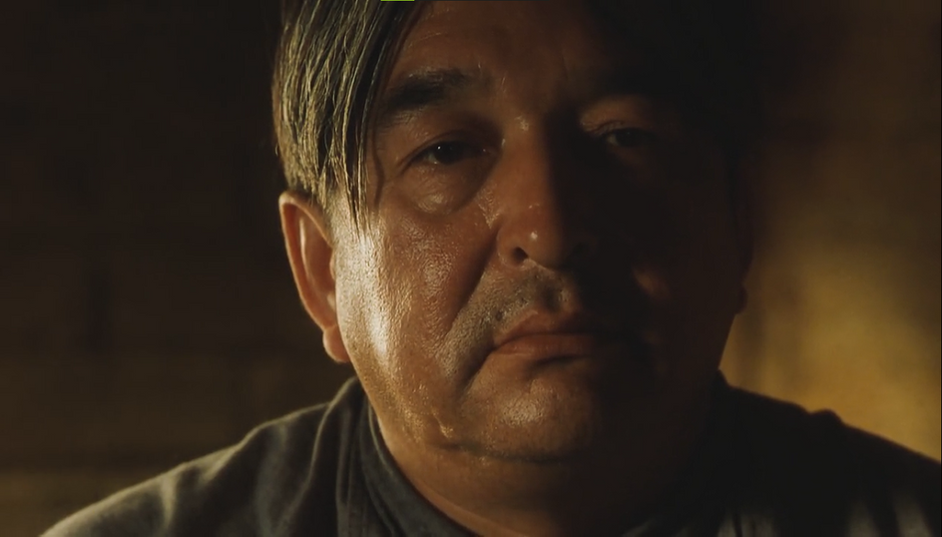
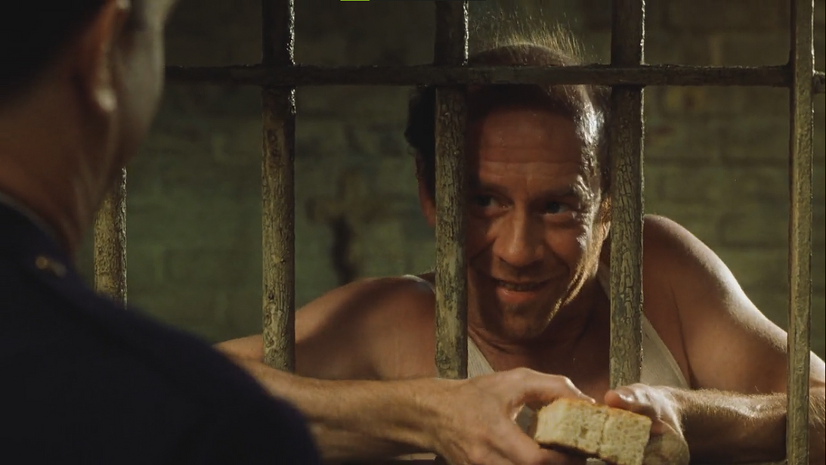
The Inmates
Edward Delacroix
Arlen Bitterbuck
He played a crucial part in bringing out the emotions and bringing more life to the prison environment. He has empathy and good humor.
who seems like a decent person who truly regrets his mistakes.He repents and wants to live the best moments of his life again.

Slide 13

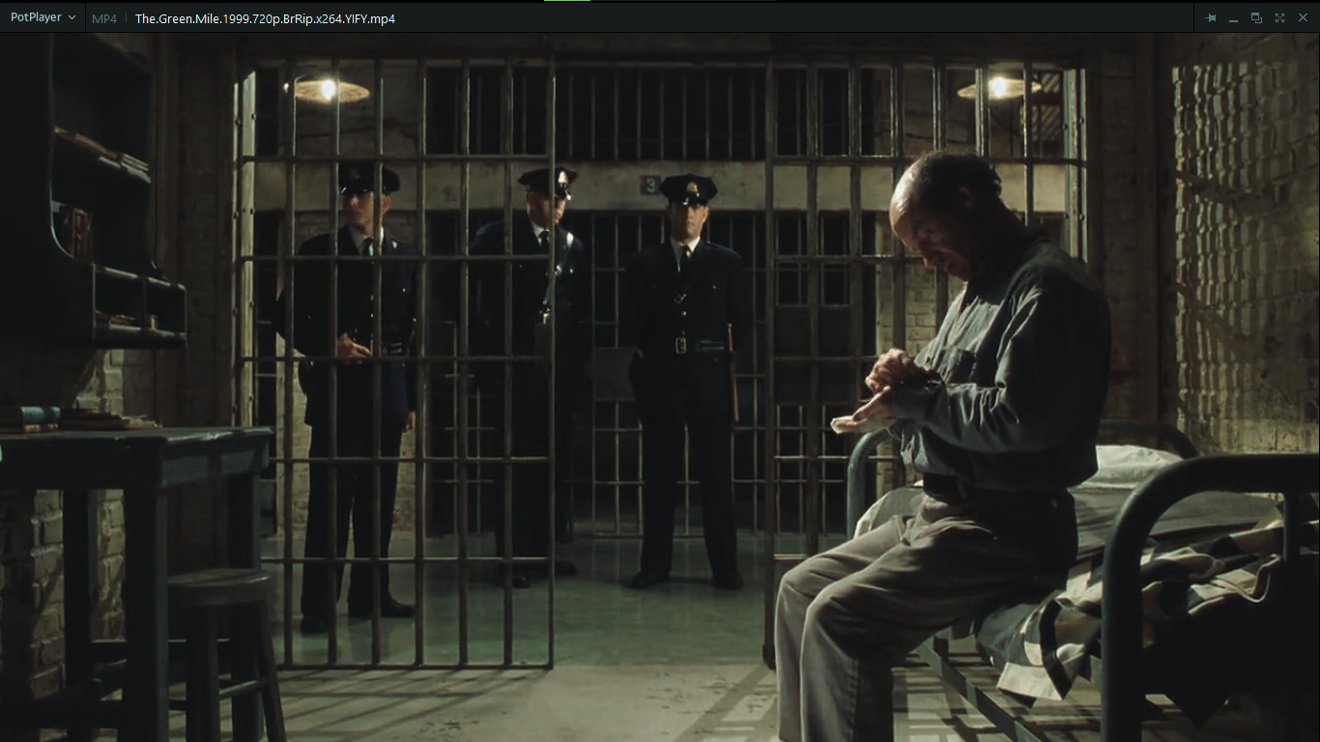
Themes: Redemption, Morality, and Symbolic Imagery
Redemption
Morality
John Coffey's story explores the possibility of redemption, even for those who have committed terrible acts.
The film portrays the human capacity for both good and evil.
Illustrates the significance of empathy regardless the situation
Symbolism
The Green Mile refers to the path everyone has to take to ultimately meet their end. John Coffey’s character conveys the power of innocence and compassion.
Notes:
4

Slide 14
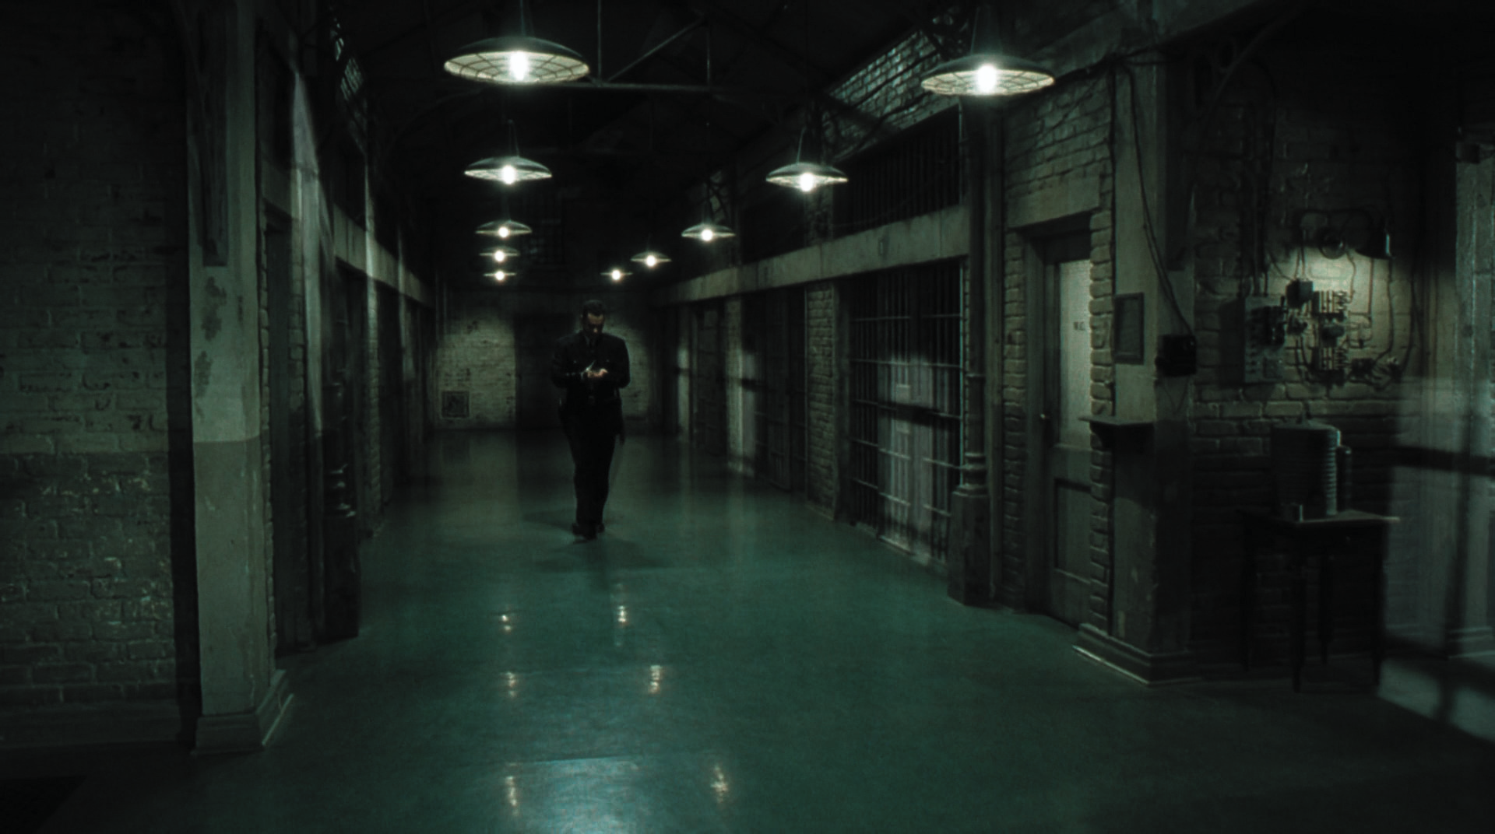
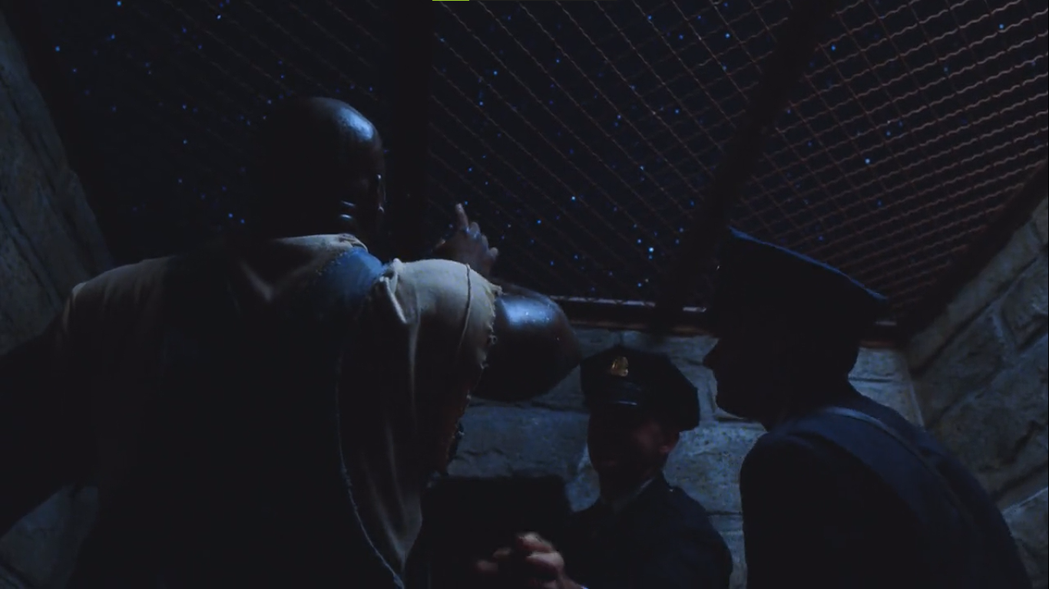

Memorable Moments:
John Coffey’s first time out under the open sky
Paul Edgecomb's emotional journey
The Acts of Empathy portraying Human nature
Symbolic messages in The Green Mile
John Coffey's Healing Abilities
Notes:
7

Slide 15


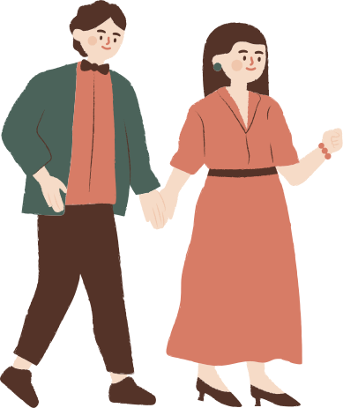


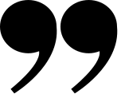
THANK YOU FOR LISTENING
We each owe a death, there are no exceptions, but oh God sometimes the Green Mile seems so long...

